Slide 1
ICBA presents:

Slide 2

Hello!
We are team ICBA
We are here to present you our project!

Slide 3
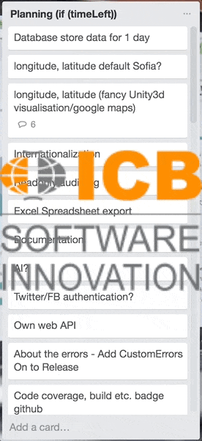
Track your Sensor (trademark pending)
What it CAN do:
Let users create, keep track on, and share sensors of interest.
Store and visualize data about existing sensors in a database.
Guests can observe public sensors
(Teaser alert) DoS ICB
What we WANTED it to do:
Track sensor’s geographical coordinates
Machine Learning Sensor Value Prediction Algorithm (MLSVPA lol)
Own web API
And much more ----->

Slide 4
The requirements:
Core
Extract info from API
Store in DB
Visualize history
Let users customize
Create a good UX
Visuals
Bootstrap
Bundling
Adequate error pages
Unit test
Continuous integration
Get to 50% code coverage
Get to 80% code coverage
Security
Identity System
Anti-forgery tokens
Error handling
Data validation (Server & Client side)
Presentation
Preparation
Practice
Enthusiasm
And more…
Service layer
Caching

Slide 5
SUCCESS!
100% of “MUST” requirements met!

Slide 6
Technologies included
Visual studio
Unity
Jenkins
JustDecompile
Slack
Paint

Slide 7
What are we proud of?
Let’s start with a simple one

Slide 8
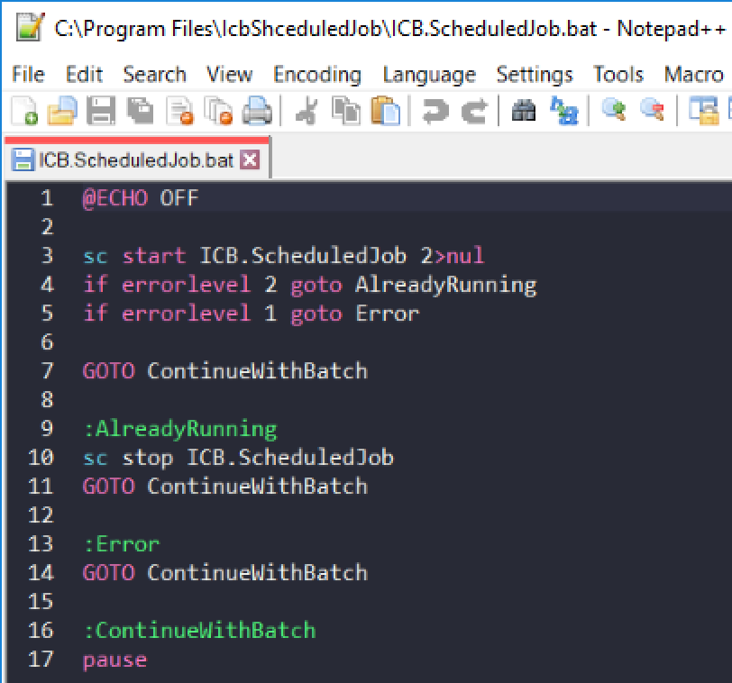
Our own script

Slide 9
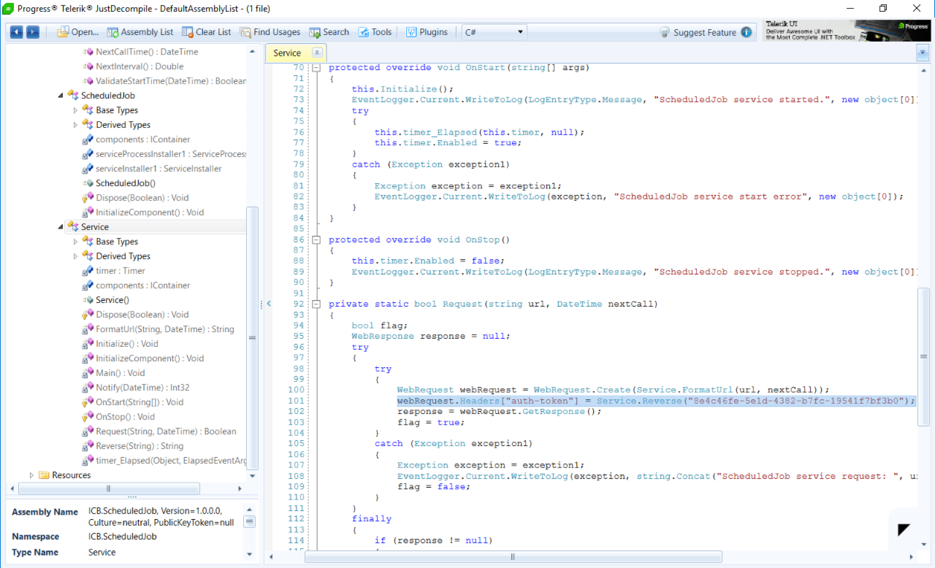
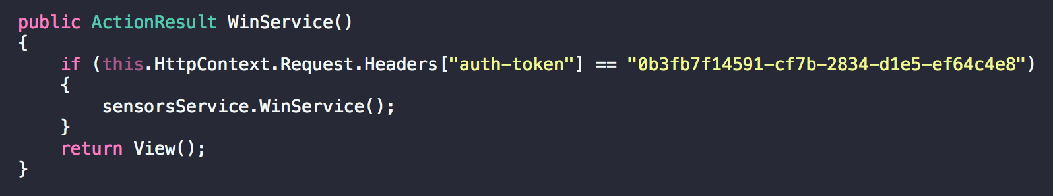
So what we did was:
1. We shamelessly decompiled your MS service;
2. We told our server what to expect;
3. We kicked out everyone else;

Slide 10
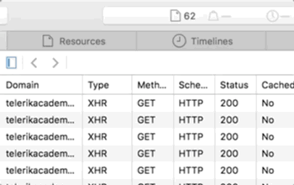
How to DoS 101
Depending on the number of sensors and their polling time, we could generate a LOT of requests
Place your screenshot here

Slide 11

Jenkins also… helped
We used Jenkins for
continuous integration

Slide 12
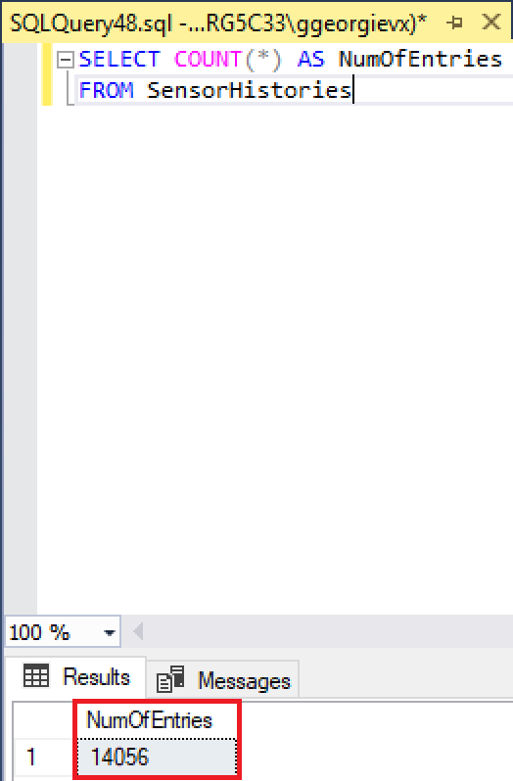
13 sensors
14,056 DB entries
= ~20hours of logging
That’s not a lot of sensors
But that is a lot of entries

Slide 13
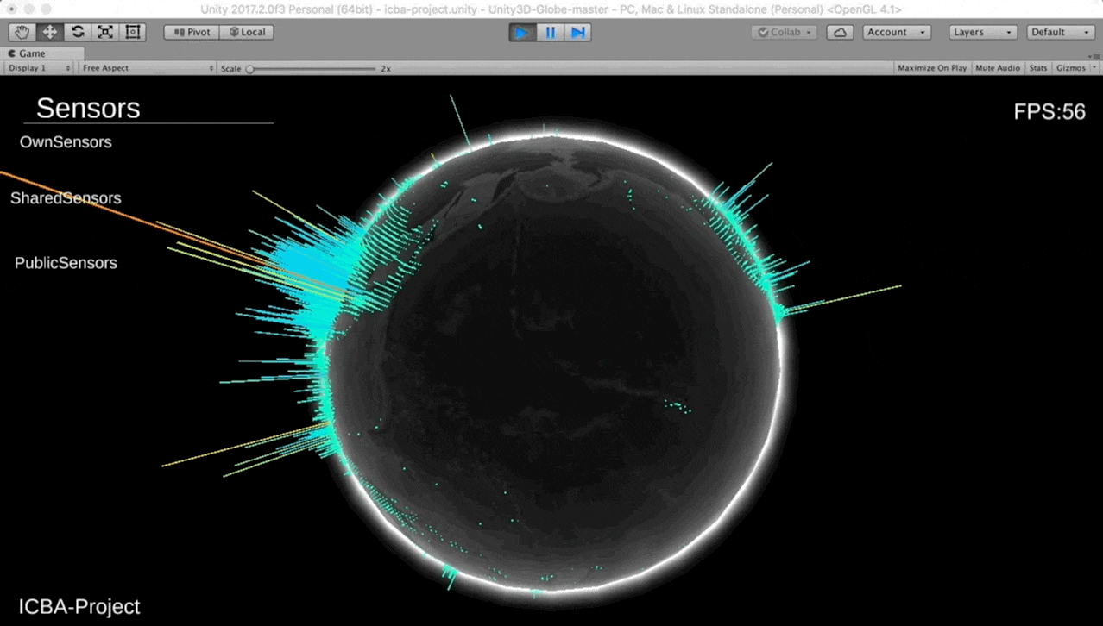

Missed opportunities
How we wanted it to look like:
What we ended up with:

Slide 14
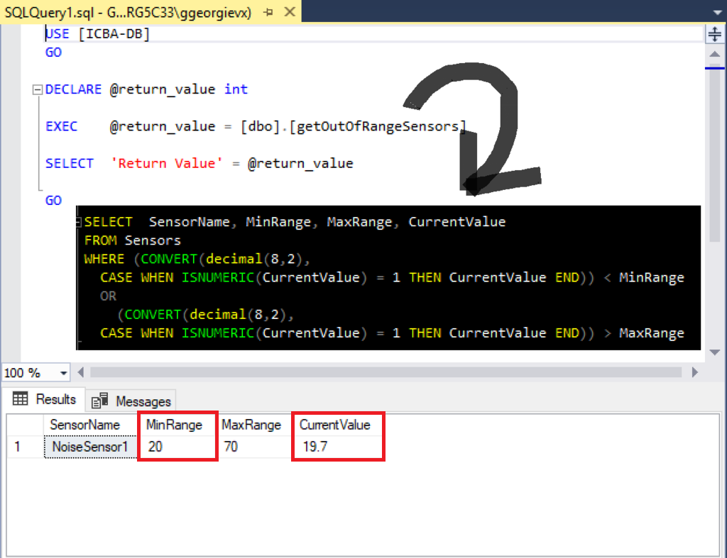
Always know when sensors values are out of range
Voice notification
Slack
notification

Slide 15
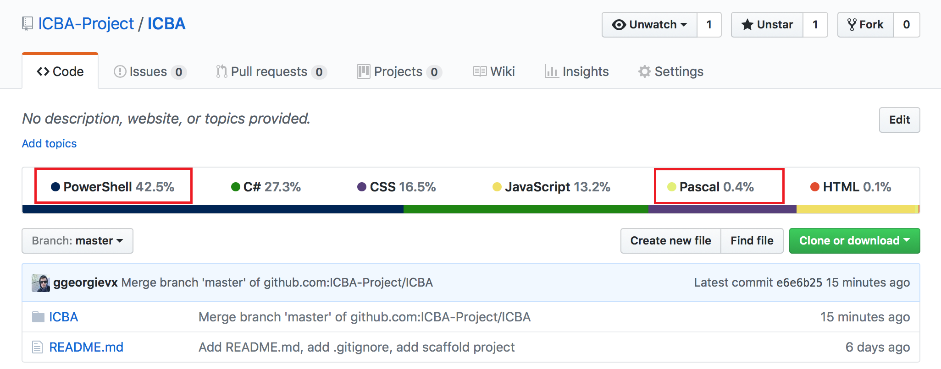
What we went through:

Slide 16
Thanks!
👍
Any questions?

Slide 17
So, when do we start?

